Slide 1
SMART ASSISTIVE SYSTEM FOR VISUALLY IMPAIRED
PIP2001 Capstone Project
VIVA-VOCE
Batch Number:CSE-91
Under the Supervision of,
Dr. Raghavendra T S
School of Computer Science and Engineering
Presidency University
Roll Number | Student Name
20211CSE0888 | ANAKHA ELIZA SHAJI
20211CSE0244 | AARON PHILIP ALEX
20211CSE0238 | KEN TOM
20211CSE0338 | RAPUR SURYA GNAAN

Slide 2
INTRODUCTION
Purpose: Empower visually impaired individuals to navigate independently and confidently in any environment.
Key Features:
Facial Recognition Module: Recognizes known faces and updates the database with new ones.
Voice Assistant Integration: Simplifies tasks like navigation, web searches, and messaging.
Obstacle Detection: Uses sensors to detect and notify users about objects, both static and dynamic.
Focus on real-world usability, adapting to dynamic conditions and user needs to enhance overall independence.

Slide 3
LITERATURE REVIEW
Context:
Traditional aids like white canes and guide dogs provide limited assistance.
Modern advancements integrate AI, sensors, and real-time feedback for improved navigation systems.
Challenges Identified:
Cost Barrier: Advanced solutions are often expensive, limiting accessibility.
Design Constraints: Existing systems often lack iterative user-centric designs, reducing effectiveness.
Dynamic Environment Limitations: Current systems struggle in crowded or rapidly changing outdoor environments.
Opportunities for Improvement:
Integration of cost-effective technologies with better real-world adaptability.
Prioritizing feedback-driven iterative designs to cater to user needs.

Slide 4
RESEARCH GAP IDENTIFIED
Research Gaps Identified
Data Fusion and Calibration Challenges
Difficulty aligning and synchronizing data from multiple sensors like RGB-D cameras and LiDAR.
Calibration issues reduce real-time system accuracy.
High Costs Limiting Accessibility
Expensive components (LiDAR, depth cameras) increase production costs.
Limited adoption prevents economies of scale.
Lack of User-Centered Designs
Insufficient real-world testing and iterative feedback.
Generic designs fail to address individual user needs.
Ineffectiveness in Dynamic Outdoor Environments
Challenges with moving obstacles, GPS inaccuracy, and environmental variability.
Struggles with real-time adaptation in dynamic scenarios.
This concise version retains the key points while being brief for presentation purposes. Let me know if further edits are needed!

Slide 5
Proposed Methodology
Face Recognition:
Implemented using OpenCV for real-time identification of individuals.
Creates a feedback loop to update unknown faces into a secure database for future recognition.
Captures live video feed, processes frames, and matches detected faces with stored data.
Allows users to name and save unrecognized faces, ensuring adaptability over time.
Navigation:
Uses MobileNet SSD model for real-time obstacle detection.
Processes video feed into frames to detect objects and compute their positions.
Provides directional guidance such as "Move Left," "Stop," or "Go Straight," based on obstacle proximity and location.
Incorporates proximity sensors to enhance accuracy in guiding users through challenging environments.
4.Voice Assistant:
Supports speech recognition and text-to-speech for seamless user interaction.
Handles multiple tasks including retrieving online information, messaging, and voice calling.
Multilingual capabilities ensure inclusivity for non-English-speaking users.
Integrated with navigation and object detection modules for a hands-free experience.
5.System Integration:
Combines facial recognition, obstacle detection, and voice assistant modules into a unified system.
Cloud-based storage ensures secure data access across multiple devices, supporting scalability and portability.

Slide 6
Objectives
Enhance Safety and Independence
Reliable obstacle detection and SOS features for safer mobility.
Boost user confidence with real-time navigation and assistance.
Improve System Accuracy
Seamless indoor and outdoor navigation with GPS and BLE.
Advanced models (YOLO, CNNs) for precise detection and recognition.
Cost-Effective and Scalable
Affordable hardware like Raspberry Pi and open-source software.
Modular design for easy upgrades and widespread adoption.

Slide 7
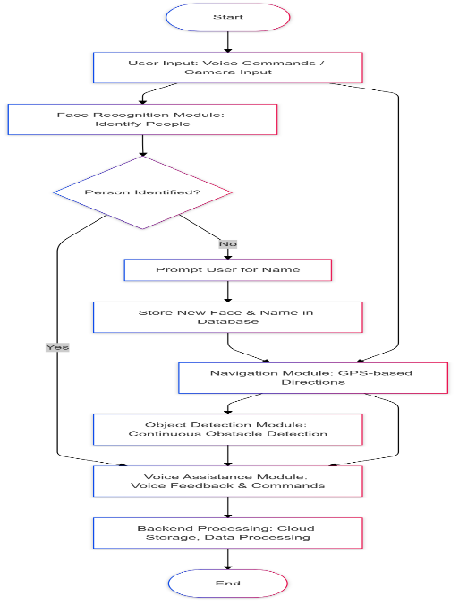
System Design & Implementation
- Architecture: hardware, software, and
cloud integration.
- Technologies used: OpenCV, YOLO,
TensorFlow, Raspberry Pi, etc.
- Multimodal feedback
mechanisms (audio, tactile, vibration).

Slide 8
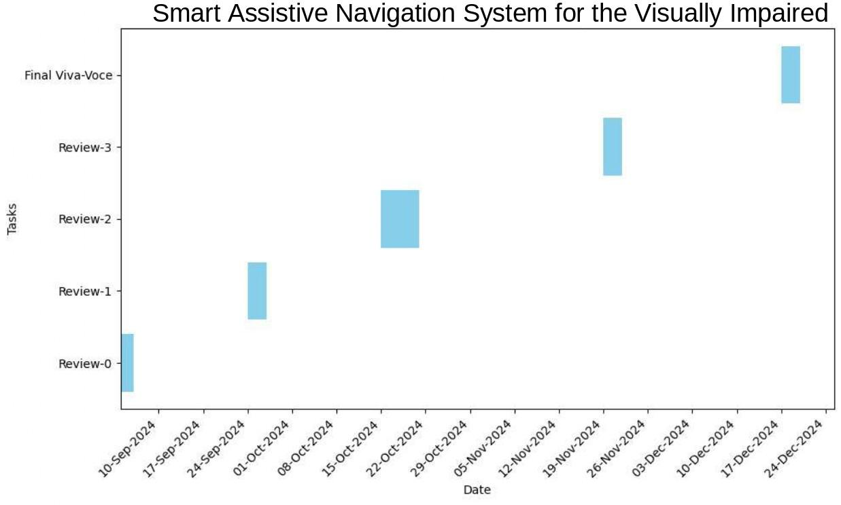
Timeline of Project

Slide 9
Outcomes / Results Obtained
- Enhanced obstacle detection and navigation.
- Reliable face recognition.
- Accessibility improvements with multimodal feedback.
- Emergency features ensuring safety.
Data Security:
Prioritizes encryption for sensitive data like GPS locations and facial information.
Ensures secure communication between hardware and software components to prevent unauthorized access.
2. Scalability:
Cloud infrastructure enables seamless data access and storage, even with device changes.
Future upgrades planned for currency recognition, multilingual voice assistance, and traffic signal detection.

Slide 10
Conclusion
NAVIA combines cutting-edge technology with practical solutions to address the challenges faced by visually impaired individuals.
Highlights include:
Facial Recognition for improved social interaction and safety.
Obstacle Detection for dynamic and static object navigation.
Voice Assistance for seamless hands-free control of tasks.
SOS Feature for enhanced safety in emergencies.
Future development plans include:
Cloud-based data storage for portability.
Additional features like currency detection, multilingual support, and real-time traffic signal identification.
NAVIA empowers visually impaired individuals to live with greater independence and confidence, transforming their everyday experiences.

Slide 11
References
[1]. A. Ramli, H. J. Kim, and Y. S. Lee, "Integration of multimodal sensor data for robust indoor localization," Sensors and Actuators A: Physical, vol. 251, pp. 1–10, 2016.
[2]. A. Muhammad Haris, R. Valérie, and L. Gérard, "Magnetic field-based heading estimation for pedestrian navigation environments," in Proceedings of the 2003 International Conference on Outdoor Positioning and Indoor Navigation, Guimarães, Portugal, 2011, pp. 21–23.
[3]. El-taher FE-z, Taha A, Courtney J, Mckeever S. "A Systematic Review of Urban Navigation Systems for Visually Impaired People." Sensors. 2021; 21(9):3103. https://doi.org/10.3390/s21093103
[4]. G. Nicholas, and G. E. Legge, "Blind navigation and the role of technology," in The Engineering Handbook of Smart Technology for Aging, Disability, and Independence, 2008, pp. 479–500.
[5]. H. Makino, D. Ito, K. Nishimori, M. Kobayashi, and D. Wakatsuki, "Pedestrian indoor navigation method, communication and autonomous navigation," in Proceedings of the 2011 International Conference on Indoor Positioning and Indoor Navigation, ETH Zurich, 2010, pp. 403–404.
[6]. H. Min and K. Sohn, "Deep learning-based live detection of pedestrian traffic signals," IEEE Transactions, vol. 20, no. 4, pp. 1464–1476, 2019.
[7]. J. K. W. Kolodziej and H. Johan, LPS Applications and Services. Taylor & Francis Group, 2006, pp. 87–164.
[8]. J. Nordin and A. M. Ali, "Indoor navigation and localization for sight impaired people," Journal of Computer Science, vol. 5, no. 11, pp. 883–889, 2009.
[9]. L. Hui, D. Houshang, B. Pat, and L. Jing, "Survey of wired outdoor positioning techniques," IEEE Transactions on Systems, Man, and Cybernetics, vol. 37, no. 12, pp. 1267–1280, 2007.
[10]. M. Nakajima and S. Haruyama, "New internal navigation system for sight impaired people using viable light communication," EUGSIP Journal on Wired Communication, vol. 2013, no. 1, p. 37, Dec. 2013.

Slide 12
Achievements (if any)
Presented and published research paper on NAVIA at the 10th ASIA
International Conference, conducted by the UTM Johor,Malaysia

Slide 13


